Slide 1

Bank Loan- Risk Analysis

Slide 2
Business problem
Banks has given loans to set of individuals and encountered risk in the form of Defaulters, which were also called NPA
Based on the past data we need to derive a pattern which helps in taking decisions on whom to be granted loan and whom to avoid

Slide 3
Approach overview
There were 2 sets of data provided by the bank personnel one is ‘application_data.csv ‘ which contains the information of all the clients at the time of applying and their repayment history, the other is ‘previous_application.csv’ contains all the information of a person’s previous loans history.
Approach
application_data.csv – is been analyzed and applied with the techniques like, identify the null values in the columns and cleaning them , identify the outliers and imputation of appropriate data like mean/median/mode values in to it, removal of unwanted columns, identify unique constraints, grouping the columns in to appropriate data sets, at last bifurcating the data based on defaulters and re-payers in to 2 different Target data sets t
previous_application.csv – is been analyzed and removed the unwanted columns by identifying null values, identify the outliers and impute them, merge the data set with the application_data.csv and derive the observations
Correlations: Identify the top 10 variable correlations and identify the observations
Plotting the Graphs: based on the income, family count, type of employment, type of education, code of gender, type of living style and region we have plotted different segmented univariate analysis and derived different observations and patterns
Based on the Flags columns by plotting different bar charts we have derived some useful insights

Slide 4

Segmented Analysis and observations

Slide 5
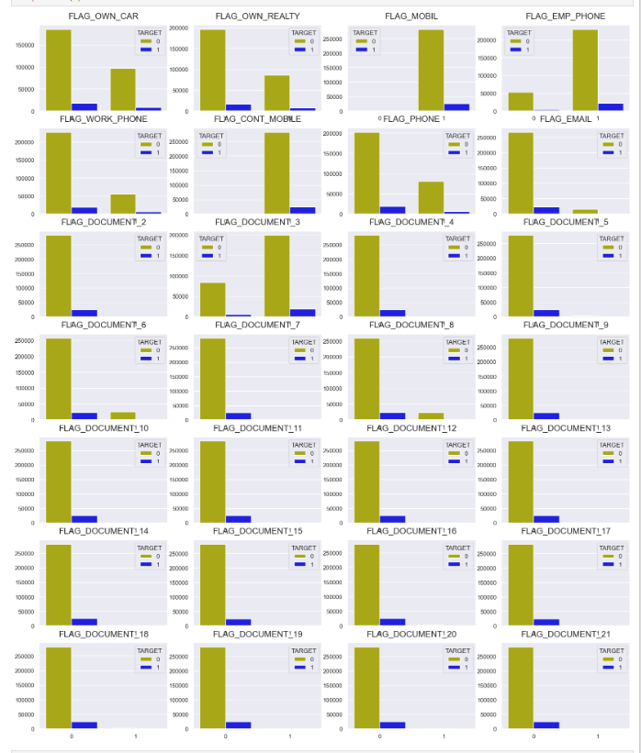
Segmented analysis
The graphs in the left shows different analysis based on the data provided by the client in the application_data.csv file, where in Defaulters were marked with
Re-payers were Marked with
How ever these details were just an assumption or Flag based, in the next slide we deep dive into data-based observations
Observations:
People who owns real estate, people provide the office phone number, people who provided the mobile number and people who submitted the document 3 were more Re-payers and all the other categories were having more defaulters

Slide 6
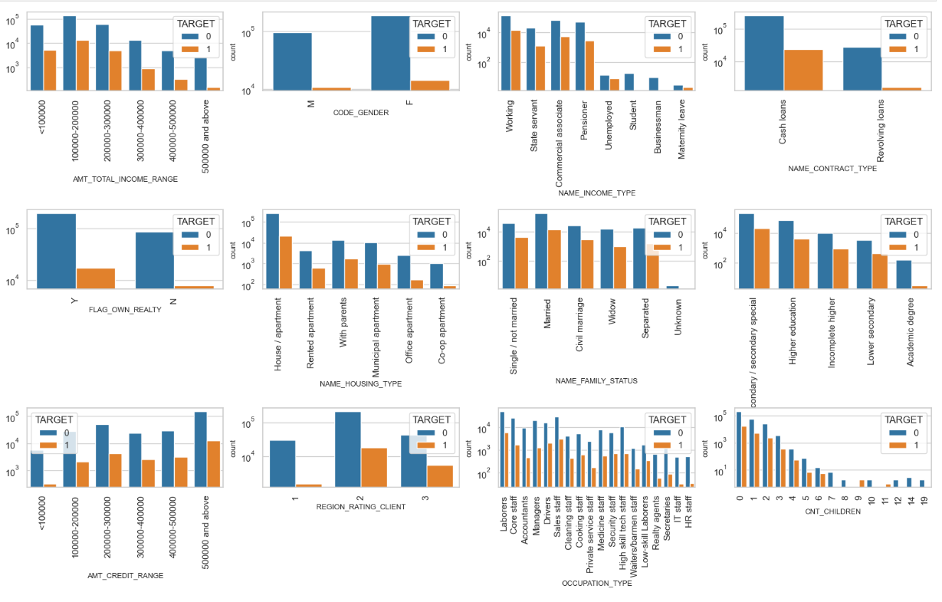
Analysis based on different types of people applied for the loans, based on which we can define which category we can offer loan or reject Tables identified : 1. AMT_TOTAL_INCOME_RANGE 2.Gender 3. Income type 4. Loan contract type 5. Owns a real estate 6. Housing type 7. Family status 8. Education type 9. Credit range 10. Region type 11. Occupation type 12. No of children

Slide 7
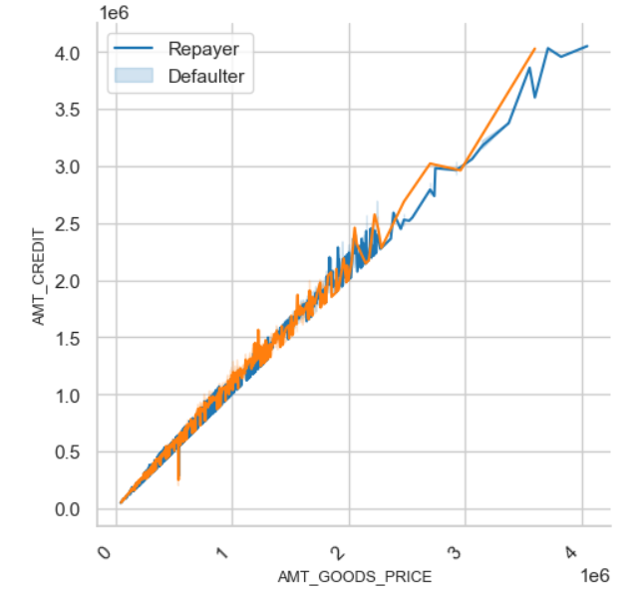
NumericalBivariate Analysis
It clearly shows that the Defaulters were raising after the Credit range crossed 30 lakhs

Slide 8
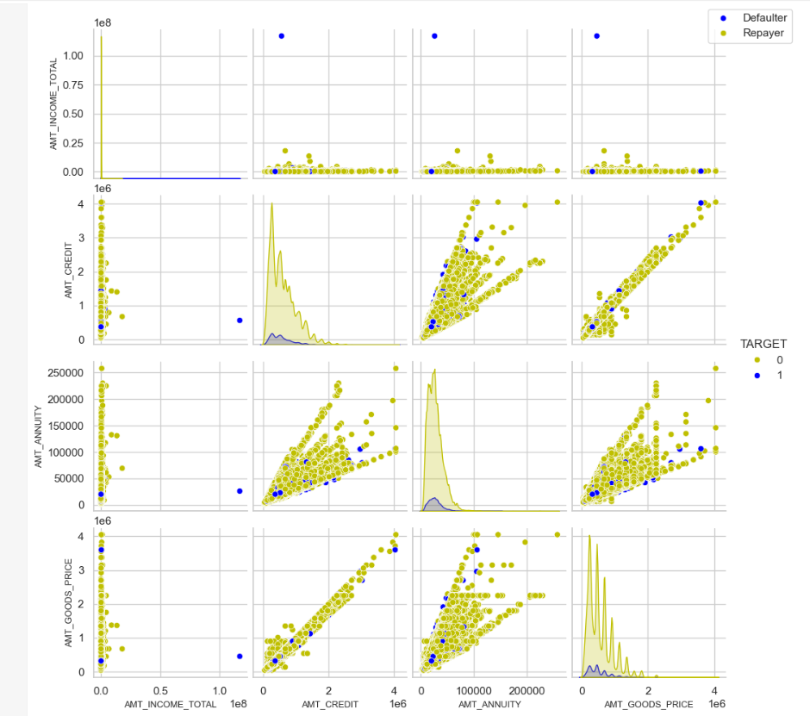
Categorical Bivariate analysis
Observations:
When Annuity Amount > 15K and Good Price Amount > 20 Lakhs, there is a lesser chance of defaulters
Loan Amount(AMT_CREDIT) and Goods price(AMT_GOODS_PRICE) are highly correlated as based on the scatterplot where most of the data are consolidated in form of a line
There are very less defaulters for AMT_CREDIT >20 Lakhs

Slide 9

Analysis based on past loans
previous_application.csv

Slide 10
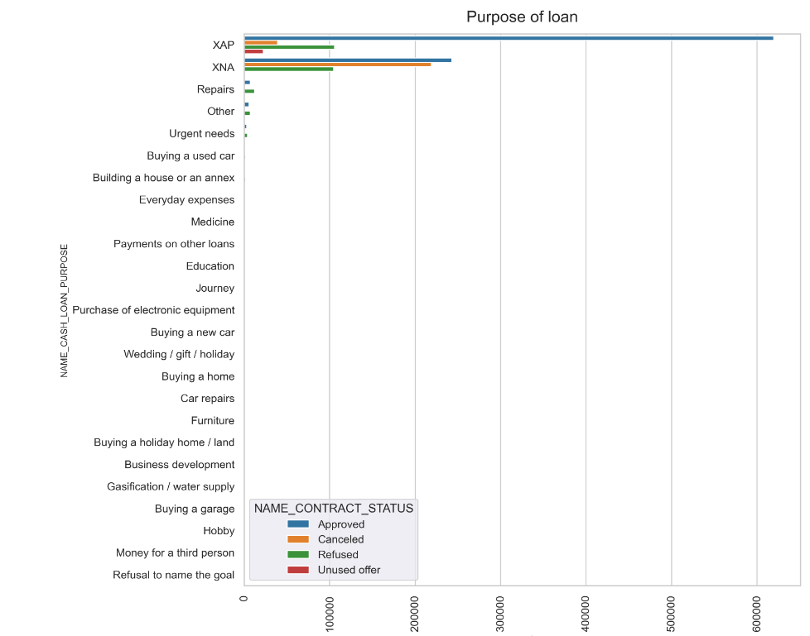
In the given data set the type of loan approved(majority) were not categorized and we can’t impute the values with any of the means, however the known category of refusal is from Repairs

Slide 11
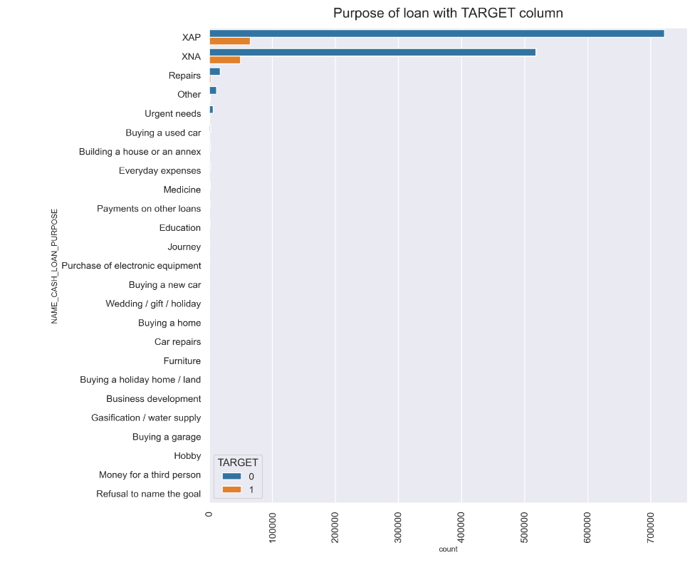
In the given data set the type of Re-payers and Defaulters category is unknown

Slide 12
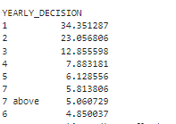
How people are interested to apply loan based on history
Based on the data people approx. 35% were likely to apply the loan in the tenure of one year of loan
23 % people like to take the loan in the 2nd year of tenure

Slide 13
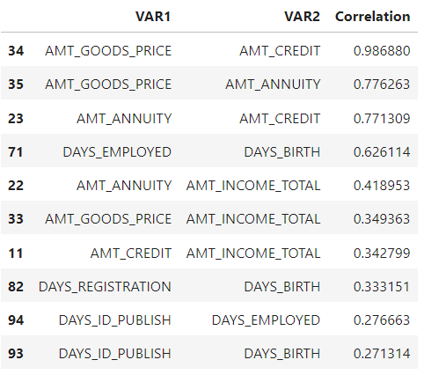
Correlations Analysis
When you do the deep dive analysis between AMT_GOODS_PRICE vs AMT_CREDIT it clearly shows that the when the credit goes on rising the defaulters rise in the same proportion

Slide 14



Overcoming Risks
Risk moderating strategies

Slide 15
Analysis made
AMT_TOTAL_INCOME_RANGE: People in range between 1L-2L were having more no of loans and the defaulter's percentage overall is very less for the income group more than 5L
Gender based defaulters :Male were more defaulters than females
INCOME_TYPE: Working income category takes more loans and the relatively high in defaulters list followed by commercial associates and pensioners, students and businessmen takes loans and pay them in time
Contract Type defaulter analysis: Revolving loan contract types were relatively low defaulters compared to cash loans
Real Estate type of Defaulters: The clients who own the real estates were more and the defaulters were less
Housing type defaulters: People live in the apartments or own house were more likely defaulted followed by people who lives with their parents and the people live in office apartment were less defaulted
Family status defaulters: Most of the people who have taken loan are married, followed by Single/not married and civil marriage, Widows were more likely to be Re-payers and Civil marriage has the highest default rates
Education type-based defaulters: People with lower secondary education were more defaulters and academic degree has less defaulters
Amount Credit Range Defaulters: People between 2L to 6L income range were more defaulters than other range of income groups
Region rating based Defaulters: People from Region 3 has more defaulter followed by Region2 and Region 1
Occupation type-based defaulters: defaulters are Low-skill Laborers, followed by Drivers and Waiters/barmen staff, Security staff, Laborers and Cooking staff
Family members-based defaulters: Children with number 9 and 11 were 100% defaulters and children with 7,8,12,14,19 were 100% Re-payers
People were more likely to take the loan within 1st 1 year of their total tenure

Slide 16

Thank you
Ranjith Cheela

